Slide 1


Serverless MongoDB with Stitch
Mongo

Slide 2
Overview
My Experience with MongoDB
SQL & NoSQL
Background
Moving Parts
MongoDB, Atlas + Stitch
RateMyBean - “An open forum to rate & review your fave beans
Authentication
Rules & Roles
Functions
Services

Slide 3
How I became a MongoDB Fan Boi
Liberis – BC finance company
Used across microservices for processing Business Cash Advance (BCA) applications
Consultancy – for digital agency on behalf of Starbucks
Seasonal stock planning web application
New store onboarding web application
My wedding – RSVP site

Slide 4
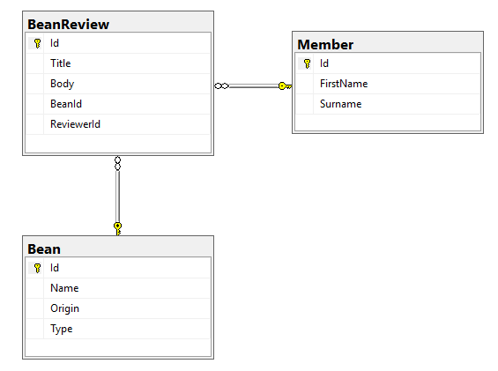
Traditional SQL
Flat, tabular data format
Normalised to reduce data redundancy and improve data integrity
Strict, structured schema
Common practice to enforce constraints
Foreign keys
Defaults

Slide 5
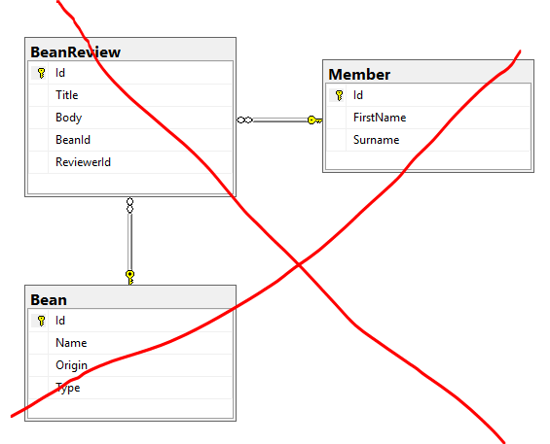
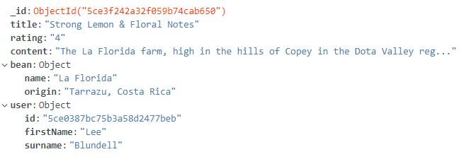
NoSQL
Refers to non relational databases
Umbrella term referring to key-value, graph and document databases (to name a few)
Notes:
Can use “references” if you did want to prevent repeating data but can be an anti pattern

Slide 6

Stitch

Slide 7
MongoDB - Primer
Cross-platform document-oriented databases
JSON-like docs, stored as BSON (Binary JSON)
Flexible schema – document structure not enforced by default
Databases, collections and documents
Opinion – enables you to focus your efforts on application requirements rather than relational data models

Slide 8
Atlas
MongoDB’s DBaaS (Database as a Service)
On-demand & elastic
Fully managed
Replica sets out of the box (even on free tier)
Can be hosted on AWS, Azure & GCP
Back bone of Stitch
Demo!
Notes:
Clusters
Replica sets
Metrics
Collections

Slide 9
Stitch - Intro
BaaS – Backend as a Service
Offers multiple features and service integrations to deliver business value faster
Store and Query Data in MongoDB
Authenticate and Manage Application Users
Define Backend Logic with Serverless Functions
Integrations
Facebook
GCP
AWS
GitHub
Twilio
Respond to Changes and Events with Triggers

Slide 10
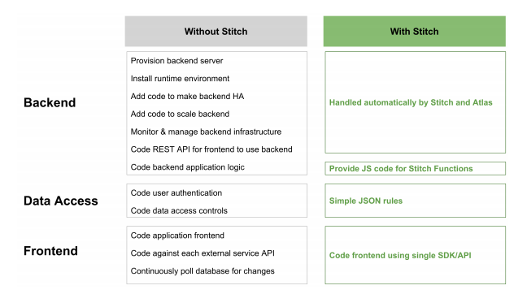
Stitch – Why do I need it?
Source: Stitch white paper

Slide 11
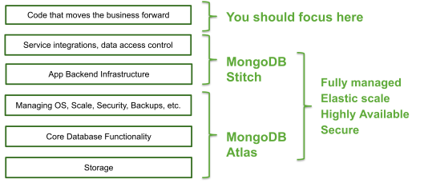
The Moving Parts

Slide 12
RateMyBean Demo - Requirements
Anyone can read reviews
Authenticated users can write reviews
Only the review owner can edit/delete their review
Reviews are linked to the user
Review images can be uploaded and retrieved from an Amazon S3 bucket

Slide 13

RateMyBean - Demo

Slide 14
RateMyBean - Auth
Authentication available out of the box. Built-in auth methods include:
Email/password
API keys
OAuth 2.0 through Facebook and Google
Anonymous
Hooks into Stitch rules to provide JSON expressions for roles

Slide 15
RateMyBean – Adding a review
Direct MongoDB access
Roles & Rules
AWS Service
Functions

Slide 16
RateMyBean – Getting reviews
Direct MongoDB access
Roles & Rules
AWS Service
Functions

Slide 17

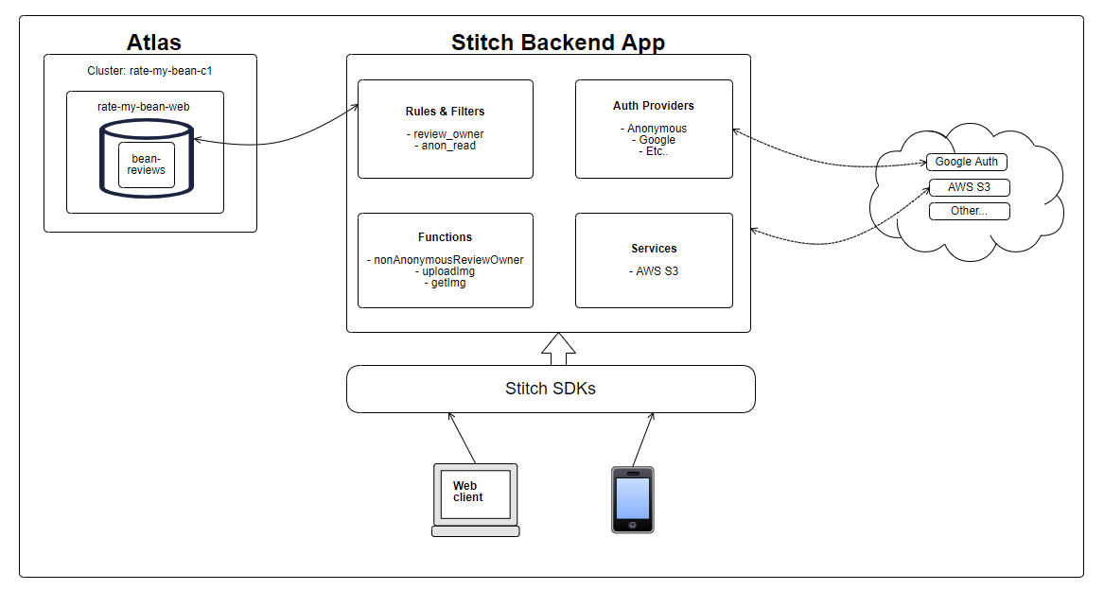
Our MVP

Slide 18
Stitch & Source Control
You can export your Stitch configuration
Stitch CLI can be used to import

Slide 19
Stitch – The good
It’s quick to get something up and running
Nice, easy to use UI
Integrations work without much effort
Having direct access to your MongoDB databases in the browser is cool
You can source control your stitch env using the Stitch CLI

Slide 20

Stitch – The not so good
The JSON expressions used for rules are hard and can easily result in runtime exceptions
Your app is hugely coupled to Stitch – it would be a rewrite to move provider if required
It’s easy to get auth wrong
There’s no local environment
The documentation is quite light. It’s to the point but I want more tutorials and comprehensive docs

Slide 21

Questions?
Thanks for listening

